Slide 1

AJAX Patterns
Multi Stage Download
Aruna S
Department of
Computer Science and Engineering

Slide 2

AJAX PATTERNS
Multi Stage Download
S. Aruna
Department of Computer Science and Engineering

Slide 3
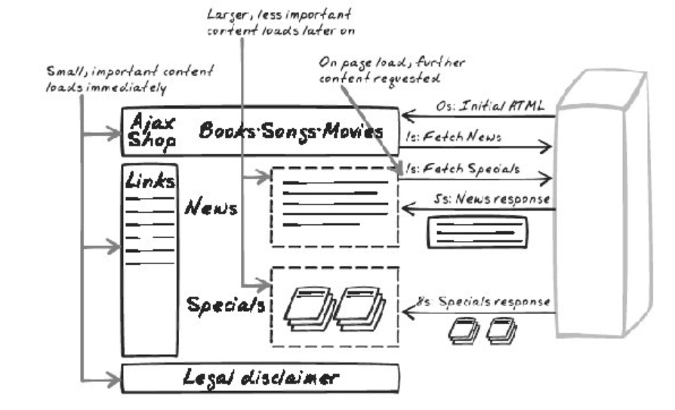
AJAX Patterns
Multi Stage Download
How can you optimize downloading performance?

Slide 4
AJAX Patterns
Multi Stage Download
The most basic functionality is loaded into a page initially
The page then begins to download other components that should appear on the page
User leaves the page before all the components are downloaded: No consequence
User stays on the page for an extended period of time: Extra functionality is loaded in the background

Slide 5
AJAX Patterns
Multi Stage Download
Advantage: You, as the developer, get to decide what is downloaded and at what point in time
When you first visit the page, it is a very simple page with minimal content
A series of requests is being fired off to fill in more content on the page
Within a few seconds, the page jumps to life as content from several different locations is pulled in and displayed.

Slide 6
AJAX Patterns
Multi Stage Download Decision factors
How will the page be divided into blocks?
How will the page be structured?
What happens to the blocks while their content is being downloaded?
Will the calls be issued simultaneously?

Slide 7
AJAX Patterns
Multi Stage Download Applications
Net vibes
Travel Search Engine
Ticket Booking website
Web Feeds

Slide 8
THANK YOU
Aruna S
Department of
Computer Science and Engineering
arunas@pes.edu

